Slide 1
Take it to the Limit:
Peak Prediction-driven Resource Overcommitment in Datacenters
Noman Bashir¹, Nan Deng², Krzysztof Rzadca^{2,3} David Irwin¹,
Sree Kodak², Rohit Jnagal²
¹ University of Massachusetts Amherst, ² Google, LLC, ³ University of Warsaw, Poland

Slide 2




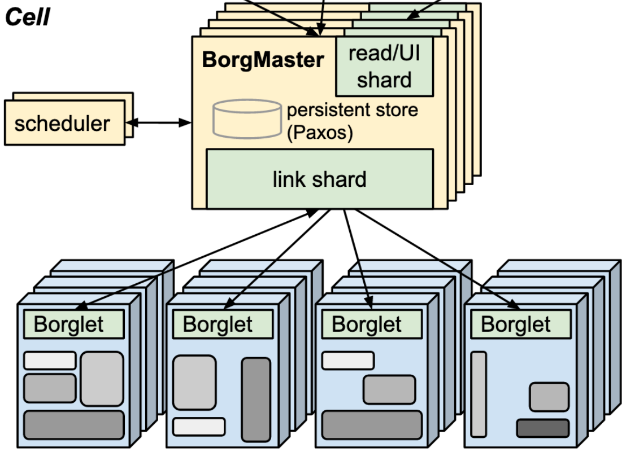
Each task has a limit on how many resource it can use, aka allocated resources.
Set by the user or an entity outside Borg, e.g., Autopilot [EuroSys’20].
internal users
tasks
Step 1: finding bins
Step 2: packing bins
BorgMaster
right hardware?
bin packing algos
got permissions?
Well-studied
free capacity?
NP-hard
without overcommit, sum of allocated resources ≤ machine’s physical capacity
Disclaimer: this is a simplified architecture for illustration purposes only, please see the Borg papers [EuroSys’15, ‘20] for details.

Slide 3





Committed to overcommit
Overcommitment: sum of allocated resources > machine’s physical capacity
A solution to increasing resource utilization and reducing costs.
Used by many datacenter schedulers, e.g., Borg, Azure’s VM scheduler.
Supported by many cloud resource management platforms.

Slide 4


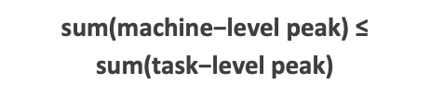
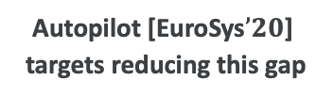
A brief overview of overcommit opportunity
Overcommit scenario: allocations ≥ 100%, utilization is < 100%.
Overcommit opportunity machine’s capacity − resource usage
Usage to limit gap: allocations to satisfy expected peak demand.
Pooling effect: peaks rarely coincide due to statistical multiplexing.
➜
$$0.3$$
$$0.42$$
$$\text{Autopilot}\text{ [}\text{EuroSys}’20\text{] }\text{targets} \text{reducing} \text{this} \text{gap}$$
$$\text{sum}\text{(}\text{machine}\text{−}\text{level} \text{peak}\text{) ≤}$$
$$\text{sum}\text{(}\text{task}\text{−}\text{level} \text{peak}\text{)}$$

Slide 5
Setting the right level of overcommit
State of the art policies typically overcommit by a fixed margin
e.g., borg’s default policy uses fixed overcommit factor.
ignore the machine’s resource usage; risky and wasteful.
Level of overcommitment
Overcommitment | zero | low | high
Allocation level | ≤ physical capacity | > physical capacity | >>> physical capacity
Resource wastage | high | low | very low
Perf. impact | none | less likely | highly likely
No evictions or performance degradation + maximum savings while being safe

Slide 6
Overcommit as the problem of finding free capacity
Overcommit problem is the problem of finding free capacity on each machine
it is complementary and orthogonal to scheduling problem.
right hardware?
bin packing algos
got permissions?
finding bins
Well-studied
overcommitment level?
free capacity?
NP-hard
packing bins

Slide 7
Key contributions
Formalize the overcommitment problem using first-principles.
Propose a general methodology of designing and evaluating overcommit policies.
Provide the tools (software and dataset) for people to follow the same methodology.

Slide 8
Overcommitment as a peak-prediction problem
Finding available capacity of “bins” is a systems problem (generally)
e.g., in Borg, scheduler polls the machines for free capacity.
Let’s assume there is
a single machine with one task running
resource allocation is 100%
scheduler asks for free capacity
Future
oracle
free
(x)
machine’s capacity
t =-∞ t = now t = ∞
Peak Oracle: provides future peak usage
future knowledge; most savings; safest.

Slide 9
Practical peak predictors
Peak oracle is impossible to implement in practice
a supervised learning problem given history and peak oracle.
enables the use of highly-available predictive tools.
Production environment puts additional constraints
e.g., low CPU and memory footprint.
Example predictors from the paper
very simple predictors with room for improvement.
peak = max(peaks across predictors)
max(predictors)
Inspired by Borg
peak = fraction of sum of limits
Inspired by Resource Central
peak = sum(x %ile of tasks usage)
based on central limit theorem
peak = mean + N times STD
borg-default
RC-like
N-sigma

Slide 10
Designing and evaluating practical peak predictors
Our problem formulation enables us to design, tune, and evaluate predictors in simulation
quickly iterate through multiple designs and scheduling scenarios.
avoid conducting risky and time-consuming experiments in production.
We release our simulator’s code under free and open-source license¹
enables future work on designing and evaluating overcommit policies.
standardized interface enables easy integration into Borg/K8s-like platform.
Start of History
t = 0
End of Horizon
compare
practical peak predictor
peak oracle
predicted peak
maximum(usage)
¹ https://github.com/googleinterns/cluster-resource-forecast

Slide 11
Measuring overcommit quality in simulation
Classic prediction quality metrics, e.g., MAPE/MSE, are not directly applicable
special cases apply for over, under, and correct predictions.
Violation rate: ratio of oracle violations and total time instances
higher the violation rate, higher the risk to the machine.
Based on SLOs certain level of violation rate may be acceptable.
prediction | is it safe? | savings? | final verdict?
> oracle | very safe | low | acceptable
= oracle | safe | high | desirable
< oracle | no | high | dangerous
oracle violation?
no
no
yes

Slide 12
Violation rate and in-production task’s performance
Quality of Service (QoS) in production
CPU scheduling latency
wait time for a ready process
low is better for serving tasks
1% increase in violation rate leads to 14.1% increase in CPU scheduling latency

Slide 13
Evaluation setup
In-simulation: using version 3 of the Google’s public cluster trace [EuroSys’20]
tune policy parameters, compare peak predictors.
In-production: datacenters running Google’s serving workloads
multiple weeks and ~24,000 machines across the globe.
an A/B experiment comparing against Borg’s default.
simulation metrics | definition
violation rate | # of violations / total timestamps
violation severity | max(0, oracle – peak)
saving ratio | (limit – peak)/limit
additional production metrics
Increase in advertised free capacity
Increase in allocations & workload
CPU scheduling latency

Slide 14
Tuning practical peak predictors
Tuning of N-Sigma peak predictor
predicted peak = mean + n x std
parameters: n, warm-up, history
Performance vs. savings tradeoff
n ↑, savings ↓, performance ↑

Slide 15
Comparing practical peak predictors
better
better
Max predictor balances savings and performance.
RC-like predictor saves more but yields low performance

Slide 16
Savings and workload increase in production
more advertised capacity ➜
more tasks allocations ➜
increase in workload
better

Slide 17
Improvement in performance
Production results match simulation
similar per-machine violation profile.
violation rate and CPU scheduling latency have same profiles.
Experiment group shows better performance than control group.
better
Notes:
We next compare the performance in terms of violation rate and CPU scheduling latency for the experiment and the control group.
There are two key takeaways from these results.

Slide 18
Improvement in performance (continued)
average utilization
99p utilization
Improved performance at higher workload
machine utilization on average is higher.
machine utilization at 99p is lower.
Performance improves due to per-machine overcommitment settings
high utilized machines face less overcommitment and vice versa.
high utilization

Slide 19
A few pointers before I let you go
Key takeaways from the talk
proposed a general methodology for designing and evaluating overcommit policies.
established a correlation between simulation results and performance in production.
demonstrated that our simple peak predictors outperform state of the art.
Potential future work
significant room for improvement in our practical peak predictors.
testing more sophisticated, but lightweight, machine learning algorithms.
Want to use our simulator?
Code: https://github.com/googleinterns/cluster-resource-forecast
Data: https://github.com/google/cluster-data
Documentation: https://github.com/googleinterns/cluster-resource-forecast/docs
Help: Noman Bashir (nbashir@umass.edu)

